Slide 1
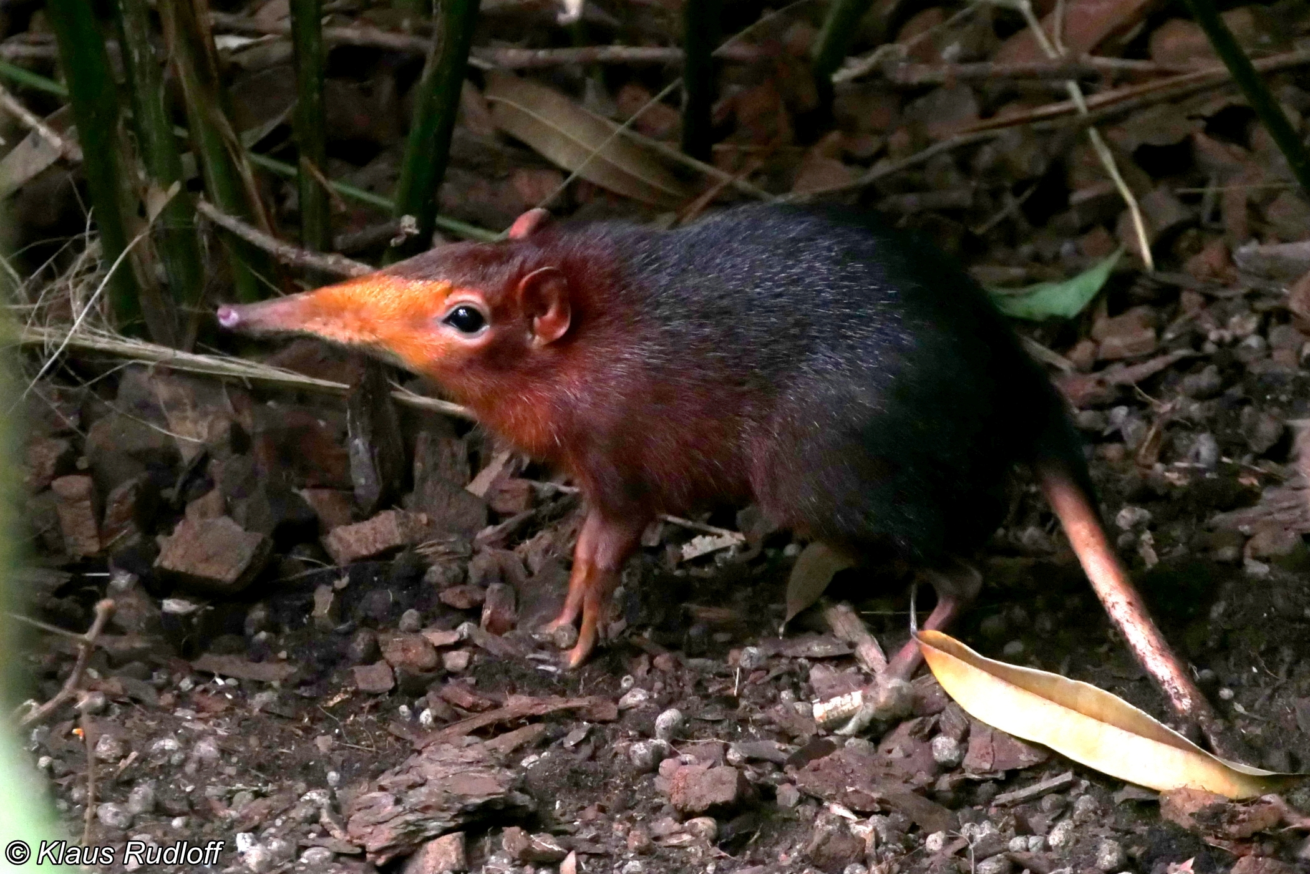
A better way to estimate population sizes

Slide 2
A menu of options
Abundance assessment techniques
Estimates
Indices
All individuals seen
Some individuals not seen
Complete Census
Capture
Census on sample plot
Removal
Capture-Mark-Recapture
Transect
Sightability models
Distance sampling
Double sampling Multiple observers

Slide 3
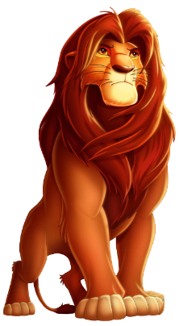
We’re still assuming a closed population
First survey
Time between surveys
Second survey
If a population is closed, we assume that there is a short time between surveys, where no reproduction or death occurs and no individuals enter or leave the site

Slide 4

Wide variety of models available to estimate $\hat{N}$
Closed Population CMR models:
Lincoln-Peterson model (2 occasions)
Allows estimation of population size
But has restrictive model assumptions
General K-samples models (>2 occasions/samples)
Allows 3 key sources of variation in capture rate to be accounted for:
Time
Heterogeneity
Behaviour
Open Population CMR models:
Used to estimate individual survival rather than population size
More on this next week

Slide 5
More sophisticated closed CMR models: K-samples models
Lincoln-Peterson model only cares if any animal has been previously marked
But if we take into account which individuals were caught we can do more
Uniquely marking individuals allows us to build unique capture histories for each individual:
A capture history looks like: 1001
1001 means Sally was captured on 1st and 4th occasion, but not on the 2nd or 3rd
Same assumptions as Lincoln-Peterson except:
Capture probabilities (p) don’t have to be identical
Requires more than 1 recapture occasion

Slide 6
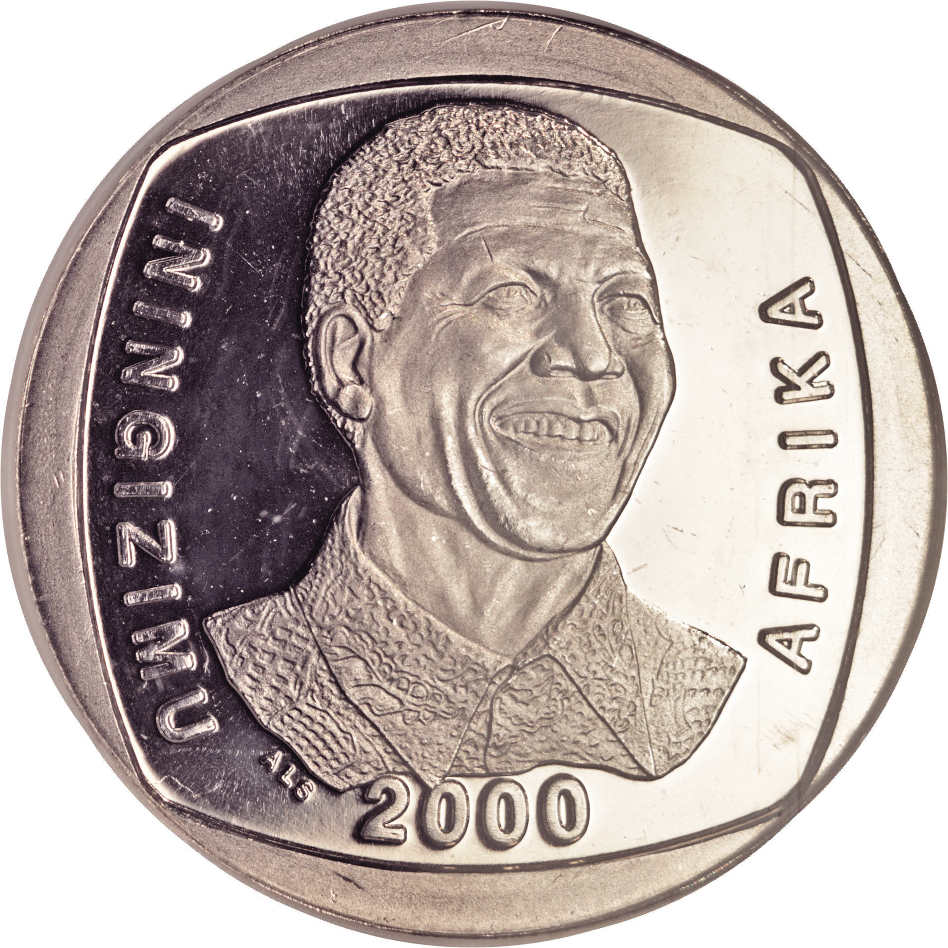
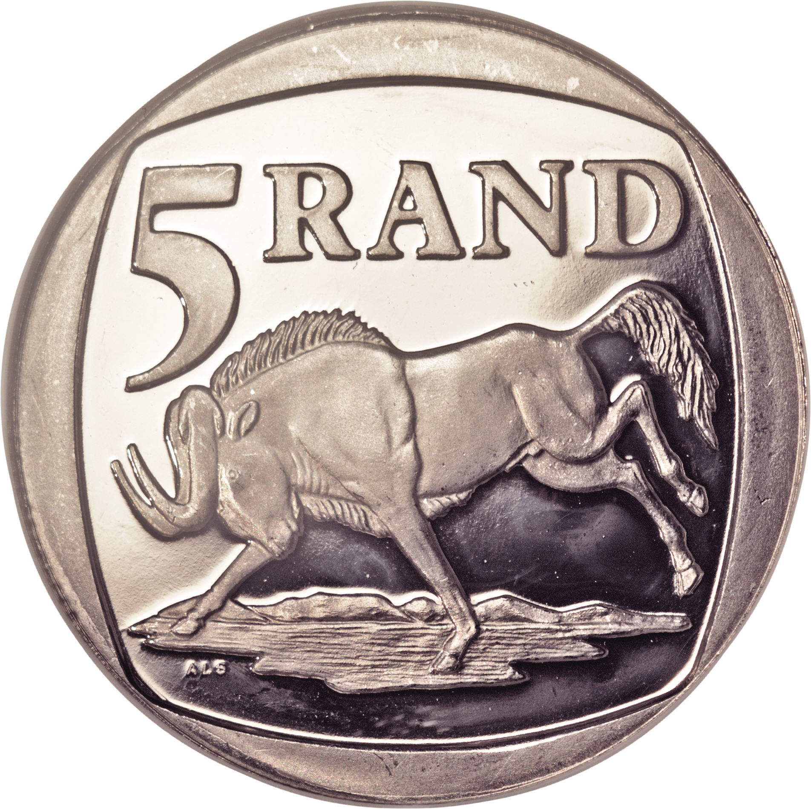
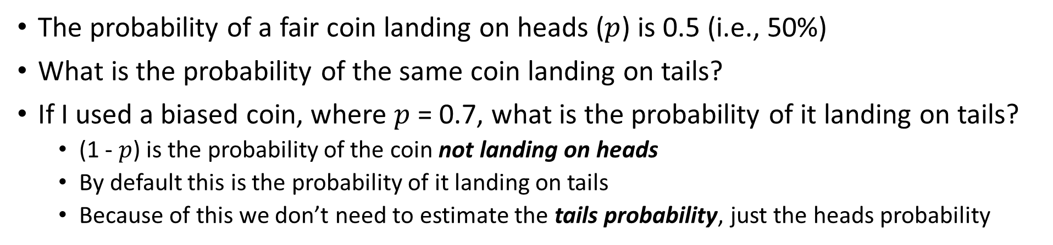
A brief tangent about a hustler tossing coins
The probability of a fair coin landing on heads ($p$) is 0.5 (i.e., 50%)
What is the probability of the same coin landing on tails?
If I used a biased coin, where $p$ = 0.7, what is the probability of it landing on tails?
(1 - $p$) is the probability of the coin not landing on heads
By default this is the probability of it landing on tails
Because of this we don’t need to estimate the tails probability, just the heads probability

Slide 7
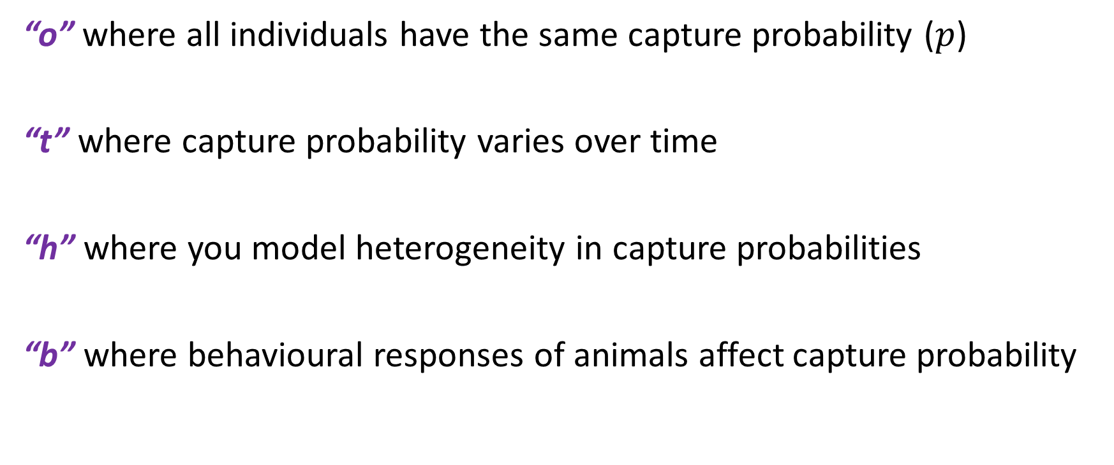
Generic types of CMR models
“o” where all individuals have the same capture probability ($p$)
“t” where capture probability varies over time
“h” where you model heterogeneity in capture probabilities
“b” where behavioural responses of animals affect capture probability

Slide 8
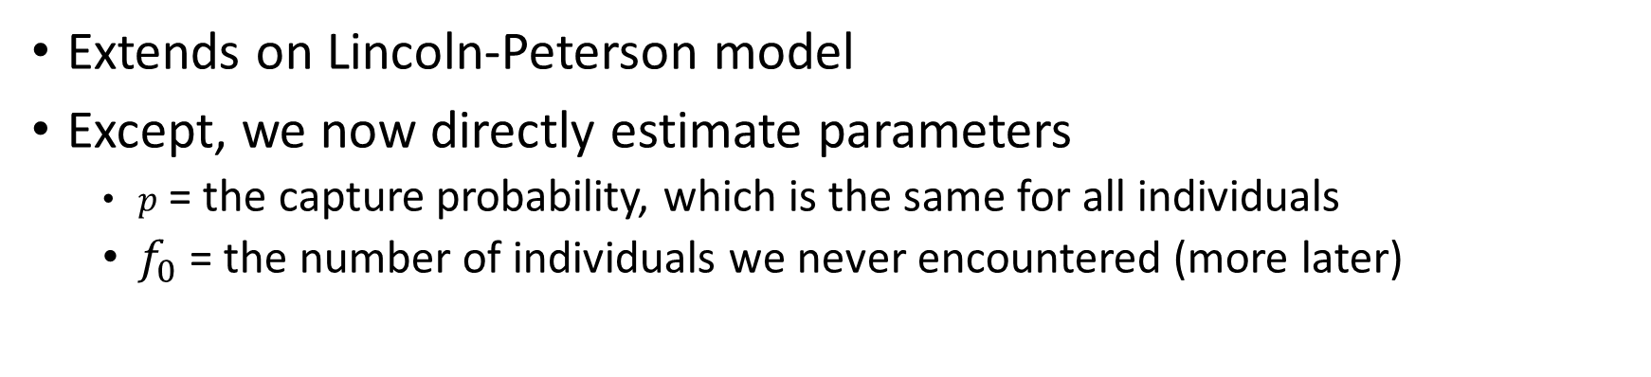

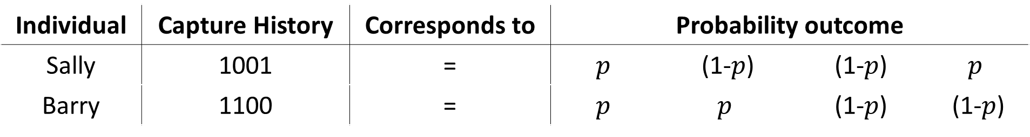

Equal capture model (or M_{o})
Extends on Lincoln-Peterson model
Except, we now directly estimate parameters
$p$ = the capture probability, which is the same for all individuals
$f_{0}$ = the number of individuals we never encountered (more later)
Individual | Capture History | Corresponds to | Probability outcome | Capture prob | Capture prob | Capture prob
Sally | 1001 | = | $$p$$ | (1-$p$) | (1-$p$) | $$p$$
Barry | 1100 | = | $$p$$ | $$p$$ | (1-$p$) | (1-$p$)
$$p$$
$$(1−p)$$

Slide 9
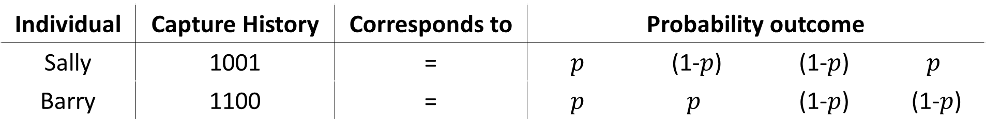
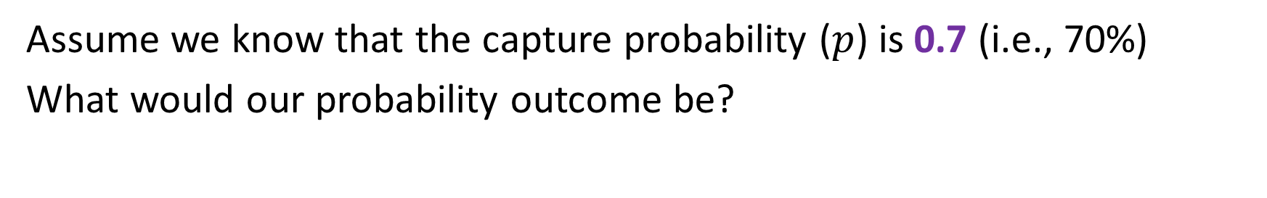
Equal capture model (or M_{o})
Assume we know that the capture probability ($p$) is 0.7 (i.e., 70%)
What would our probability outcome be?
Individual | Capture History | Corresponds to | Probability outcome | Capture prob | Capture prob | Capture prob
Sally | 1001 | = | $$p$$ | (1-$p$) | (1-$p$) | $$p$$
Barry | 1100 | = | $$p$$ | $$p$$ | (1-$p$) | (1-$p$)
Individual | Capture History | Corresponds to | Probability outcome | Capture prob | Capture prob | Capture prob
Sally | 1001 | = | 0.7 | 0.3 | 0.3 | 0.7
Barry | 1100 | = | 0.7 | 0.7 | 0.3 | 0.3

Slide 10
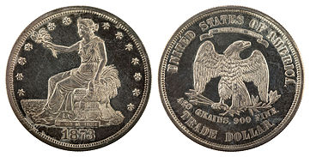
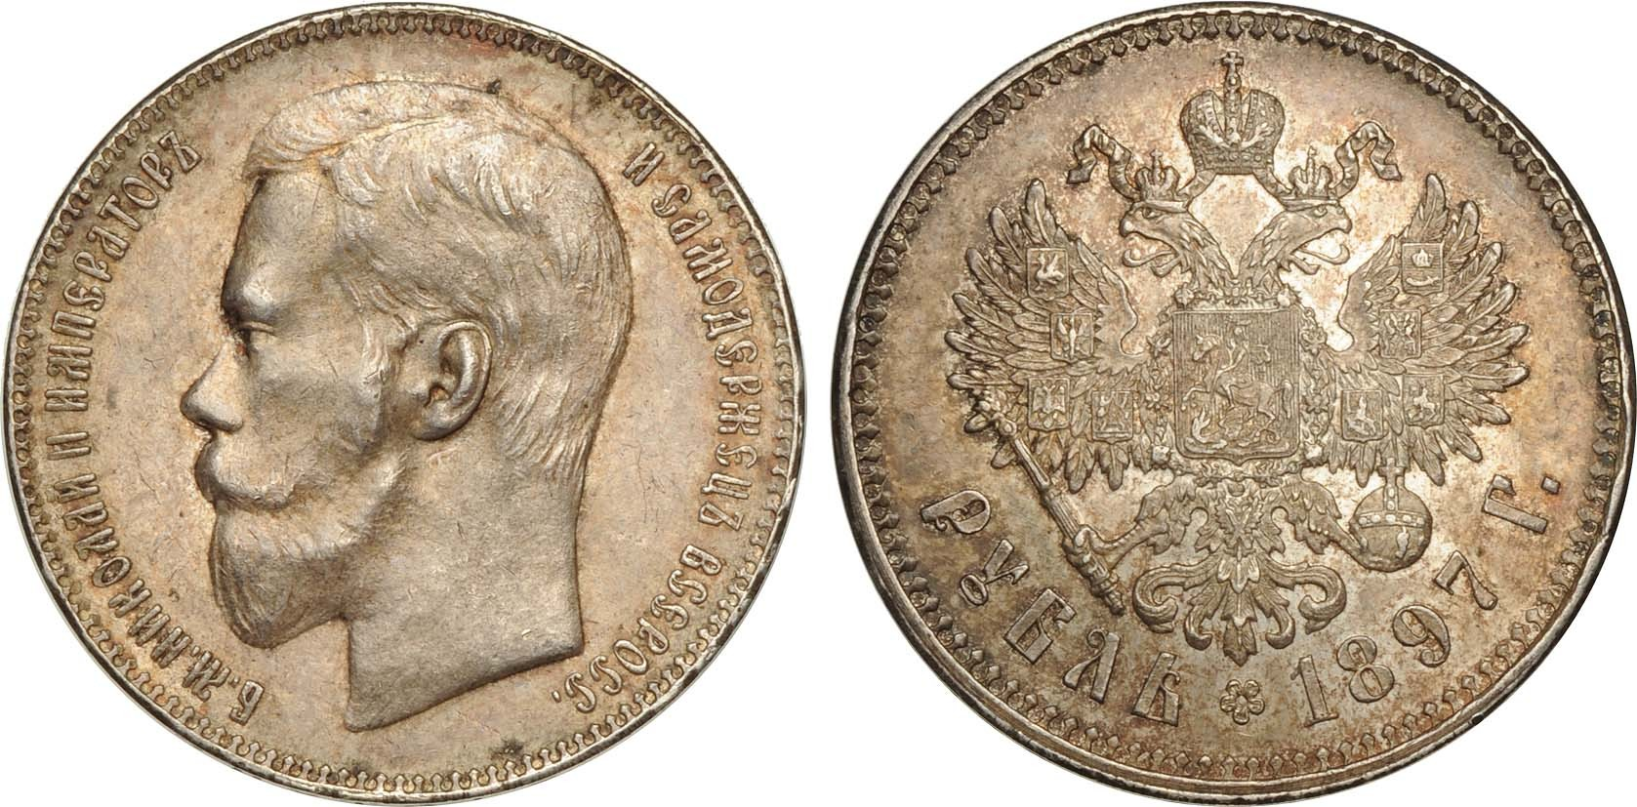
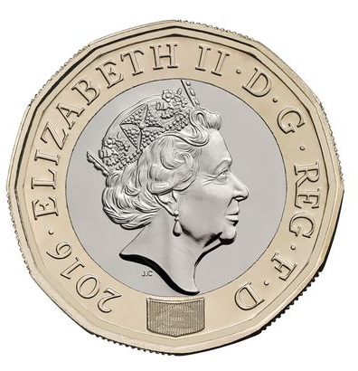

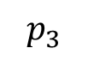

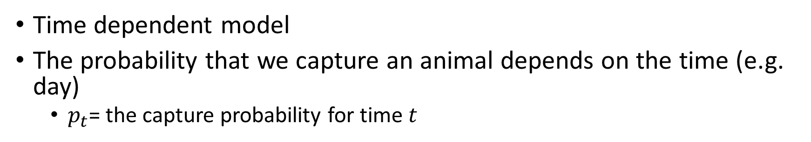

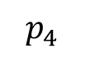

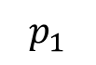

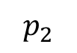

Time dependent model (or M_{t})
Time dependent model
The probability that we capture an animal depends on the time (e.g. day)
$p_{t}$= the capture probability for time $t$
Individual | Capture History | Corresponds to | Probability outcome | Capture prob | Capture prob | Capture prob
Sally | 1001 | = | $$p_{1}$$ | (1-$p_{2}$) | (1-$p_{3}$) | $$p_{4}$$
Barry | 1100 | = | $$p_{1}$$ | $$p_{2}$$ | (1-$p_{3}$) | (1-$p_{4}$)
$$p_{1}$$
$$(1−p_{1})$$
$$p_{2}$$
$$(1−p_{2})$$
$$p_{3}$$
$$(1−p_{3})$$
$$p_{4}$$
$$(1−p_{4})$$

Slide 11
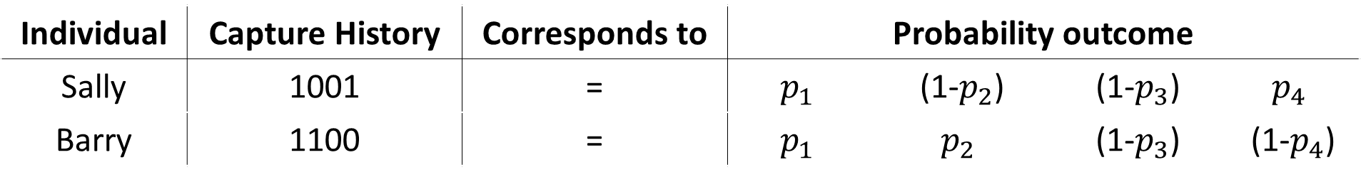
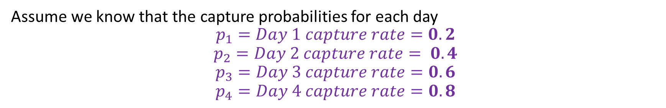
Time dependent model (or M_{t})
Assume we know that the capture probabilities for each day
$$p_{1}=Day 1 capture rate=0.2$$
$$p_{2}=Day 2 capture rate= 0.4$$
$$p_{3}=Day 3 capture rate=0.6$$
$$p_{4}=Day 4 capture rate=0.8$$
Individual | Capture History | Corresponds to | Probability outcome | Capture prob | Capture prob | Capture prob
Sally | 1001 | = | $$p_{1}$$ | (1-$p_{2}$) | (1-$p_{3}$) | $$p_{4}$$
Barry | 1100 | = | $$p_{1}$$ | $$p_{2}$$ | (1-$p_{3}$) | (1-$p_{4}$)
Individual | Capture History | Corresponds to | Probability outcome | Capture prob | Capture prob | Capture prob
Sally | 1001 | = | 0.2 | 0.6 | 0.4 | 0.8
Barry | 1100 | = | 0.2 | 0.4 | 0.4 | 0.2

Slide 12
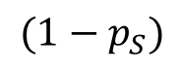
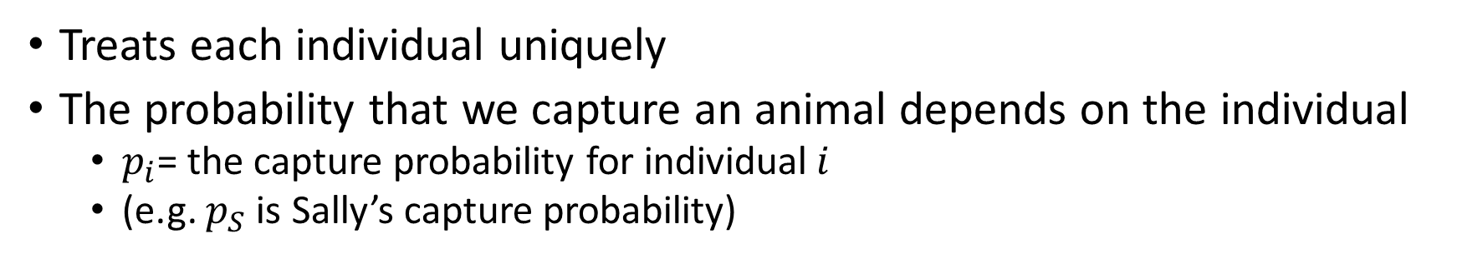
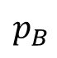

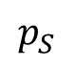
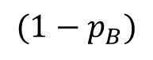
Heterogeneity model (or M_{h})
Treats each individual uniquely
The probability that we capture an animal depends on the individual
$p_{i}$= the capture probability for individual$i$
(e.g. $p_{S}$ is Sally’s capture probability)
Individual | Capture History | Corresponds to | Probability outcome | Capture prob | Capture prob | Capture prob
Sally | 1001 | = | $$p_{S}$$ | (1-$p_{S}$) | (1-$p_{S}$) | $$p_{S}$$
Barry | 1100 | = | $$p_{B}$$ | $$p_{B}$$ | (1-$p_{B}$) | (1-$p_{B}$)
$$p_{S}$$
$${(1−p}_{S})$$
$$p_{B}$$
$${(1−p}_{B})$$

Slide 13

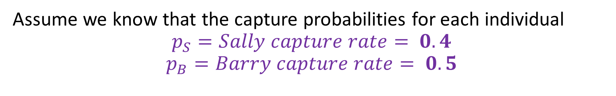
Heterogeneity model (or M_{h})
Assume we know that the capture probabilities for each individual
$$p_{S}=Sally capture rate= 0.4$$
$$p_{B}=Barry capture rate= 0.5$$
Individual | Capture History | Corresponds to | Probability outcome | Capture prob | Capture prob | Capture prob
Sally | 1001 | = | $$p_{S}$$ | (1-$p_{S}$) | (1-$p_{S}$) | $$p_{S}$$
Barry | 1100 | = | $$p_{B}$$ | $$p_{B}$$ | (1-$p_{B}$) | (1-$p_{B}$)
Individual | Capture History | Corresponds to | Probability outcome | Capture prob | Capture prob | Capture prob
Sally | 1001 | = | 0.4 | 0.6 | 0.6 | 0.4
Barry | 1100 | = | 0.5 | 0.5 | 0.5 | 0.5

Slide 14
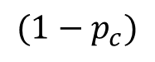
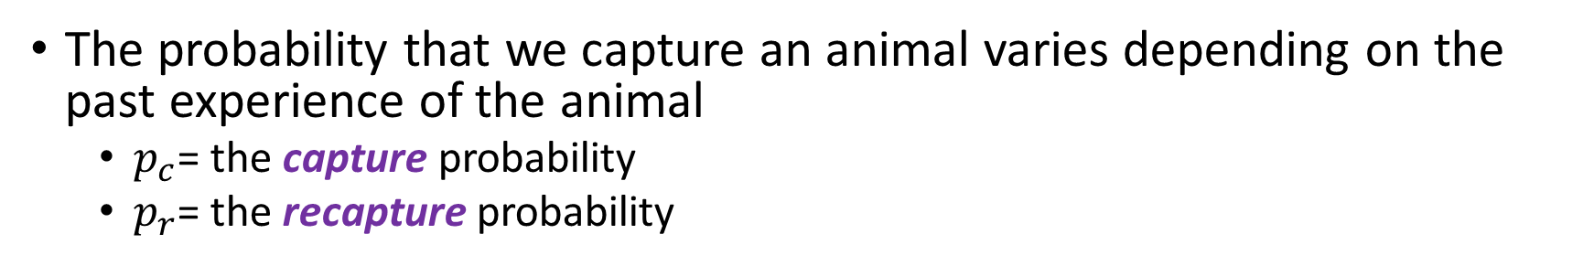
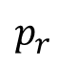
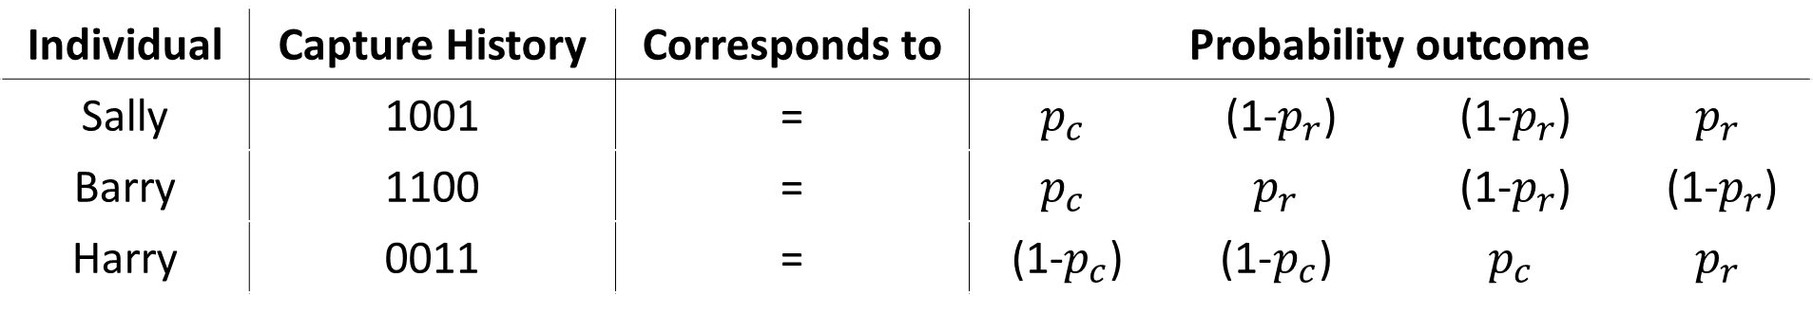
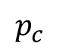
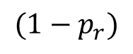
Behavioural model (or M_{b})
The probability that we capture an animal varies depending on the past experience of the animal
$p_{c}$= the capture probability
$p_{r}$= the recapture probability
Individual | Capture History | Corresponds to | Probability outcome | Capture prob | Capture prob | Capture prob
Sally | 1001 | = | $$p_{c}$$ | (1-$p_{r}$) | (1-$p_{r}$) | $$p_{r}$$
Barry | 1100 | = | $$p_{c}$$ | $$p_{r}$$ | (1-$p_{r}$) | (1-$p_{r}$)
Harry | 0011 | = | (1-$p_{c}$) | $$\text{(1−}p_{c}\text{)}$$ | $$p_{c}$$ | $$p_{r}$$
$$p_{c}$$
$${(1−p}_{c})$$
$$p_{r}$$
$${(1−p}_{r})$$

Slide 15

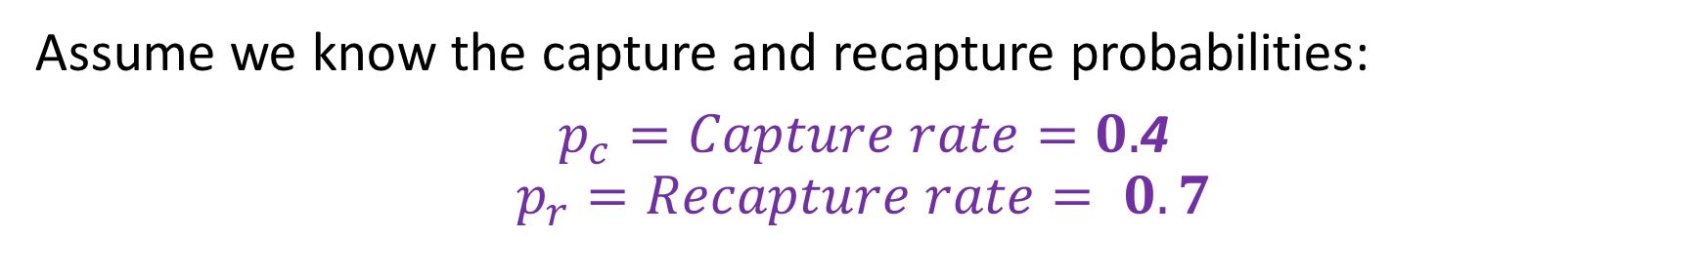
Behavioural model (or M_{b})
Assume we know the capture and recapture probabilities:
$p_{c}=Capture rate=0.$4
$$p_{r}=Recapture rate= 0.7$$
Individual | Capture History | Corresponds to | Probability outcome | Capture prob | Capture prob | Capture prob
Sally | 1001 | = | $$p_{c}$$ | (1-$p_{r}$) | (1-$p_{r}$) | $$p_{r}$$
Barry | 1100 | = | $$p_{c}$$ | $$p_{r}$$ | (1-$p_{r}$) | (1-$p_{r}$)
Harry | 0011 | = | (1-$p_{c}$) | $$\text{(1−}p_{c}\text{)}$$ | $$p_{c}$$ | $$p_{r}$$
Individual | Capture History | Corresponds to | Probability outcome | Capture prob | Capture prob | Capture prob
Sally | 1001 | = | 0.4 | 0.3 | 0.3 | 0.7
Barry | 1100 | = | 0.4 | 0.7 | 0.3 | 0.3
Harry | 0011 | = | 0.6 | 0.6 | 0.4 | 0.6

Slide 16
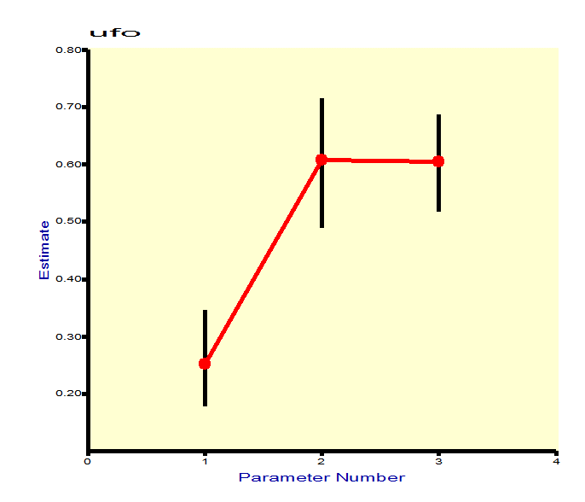

After estimating $p$, what about $\hat{N}$

Slide 17
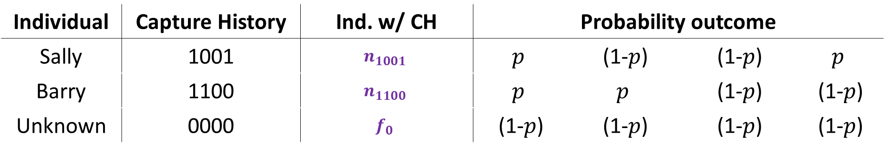

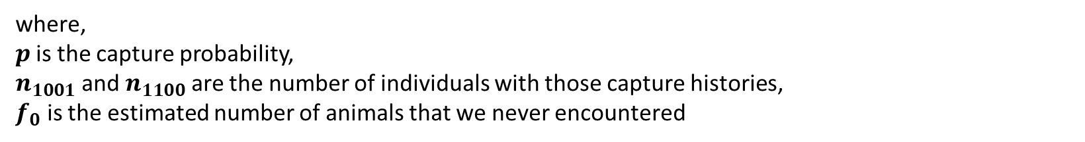
How do we go from $p$ to $\hat{N}$
Let’s work with the equal capture model
Individual | Capture History | Ind. w/ CH | Probability outcome | Capture prob | Capture prob | Capture prob
Sally | 1001 | $$n_{1001}$$ | $$p$$ | (1-$p$) | (1-$p$) | $$p$$
Barry | 1100 | $$n_{1100}$$ | $$p$$ | $$p$$ | (1-$p$) | (1-$p$)
Unknown | 0000 | $$f_{0}$$ | (1-$p$) | (1-$p$) | (1-$p$) | (1-$p$)
What we are asking the model to solve
The observed data
The two parameters we need to estimate
where,
$p$ is the capture probability,
$n_{1001}$ and $n_{1100}$ are the number of individuals with those capture histories,
$f_{0}$ is the estimated number of animals that we never encountered

Slide 18
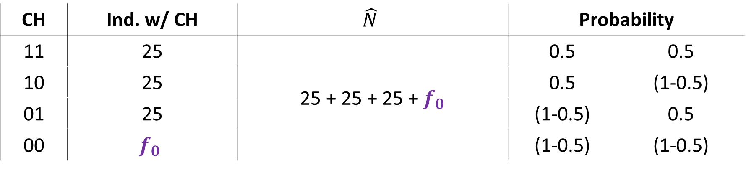

Why do we need to estimate $f_{0}$?
Imagine we do trapping for 2 days
Note that we are “blind” to the 00 CH
CH | Ind. w/ CH | $$\hat{N}$$ | Probability | Capture prob
11 | 25 | 25 + 25 + 25 + $f_{0}$ | 0.5 | 0.5
10 | 25 |  | 0.5 | (1-0.5)
01 | 25 |  | (1-0.5) | 0.5
00 | $$f_{0}$$ | 29 + 29 + 29 + $f_{0}$ | (1-0.5) | (1-0.5)

Slide 19
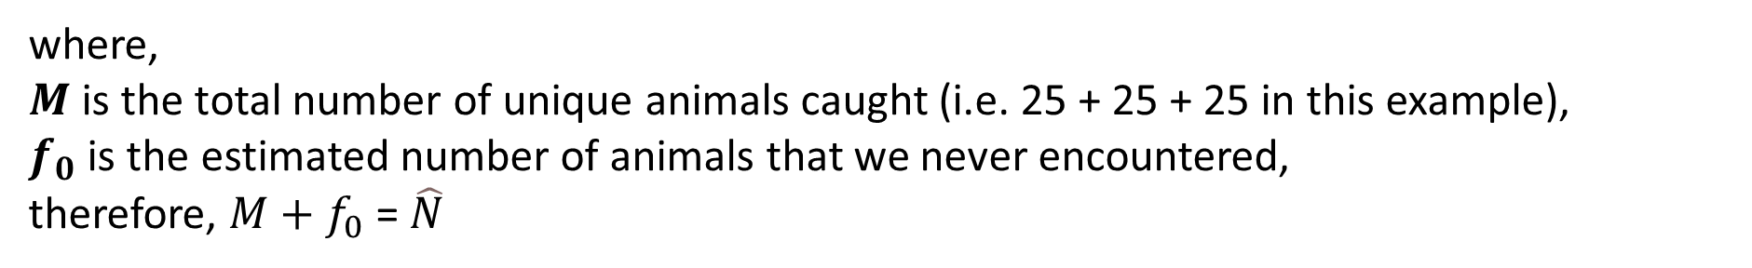

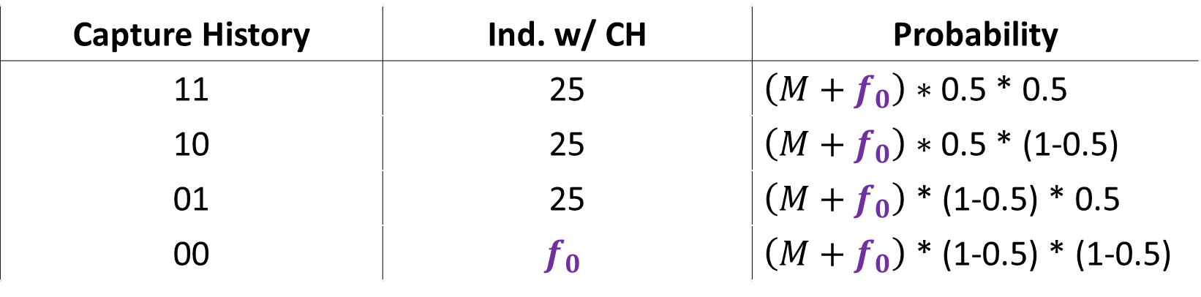
How do we estimate $f_{0}$?
Capture History | Ind. w/ CH | Probability
11 | 25 | $\left(M+f_{0}\right)∗$ 0.5 * 0.5
10 | 25 | $\left(M+f_{0}\right)∗$ 0.5 * (1-0.5)
01 | 25 | $\left(M+f_{0}\right)$ * (1-0.5) * 0.5
00 | $$f_{0}$$ | $\left(M+f_{0}\right)$ * (1-0.5) * (1-0.5)
where,
$M$ is the total number of unique animals caught (i.e. 25 + 25 + 25 in this example),
$f_{0}$ is the estimated number of animals that we never encountered,
therefore, $M+f_{0}$ = $\hat{N}$

Slide 20
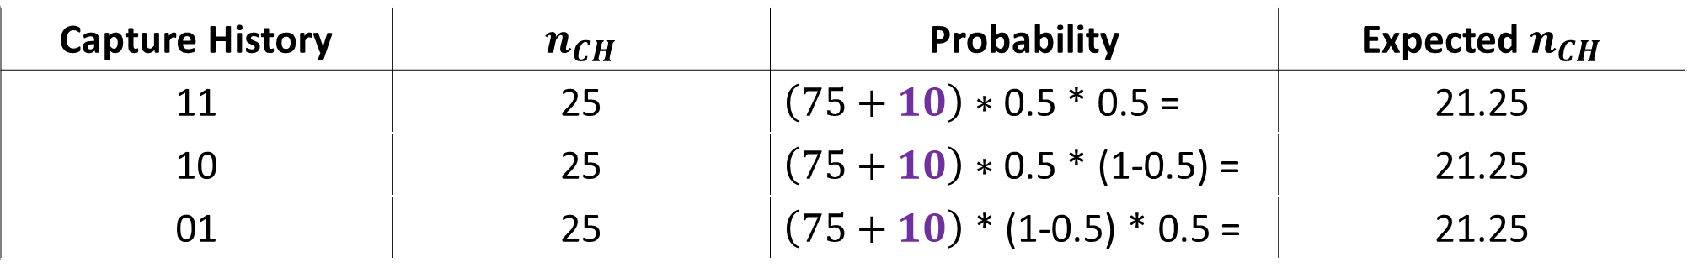

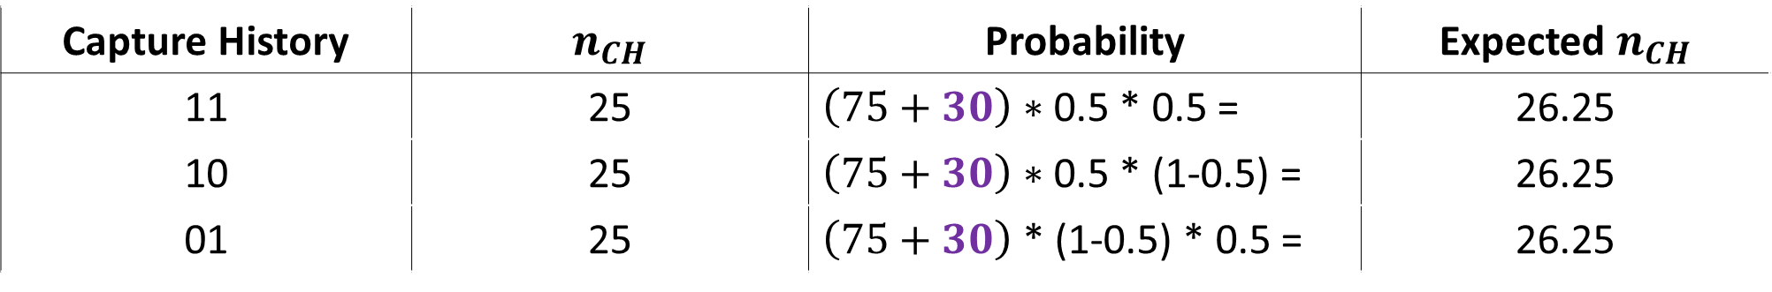

Ranking values by “eye”
Let’s try assuming $f_{0}$ is 10 (i.e. we failed to encounter 10 animals)
Capture History | $n_{CH}$ | Probability | Expected $n_{CH}$
11 | 25 | $\left(75+10\right)∗$ 0.5 * 0.5 = | 21.25
10 | 25 | $\left(75+10\right)∗$ 0.5 * (1-0.5) = | 21.25
01 | 25 | $\left(75+10\right)$ * (1-0.5) * 0.5 = | 21.25
How about assuming $f_{0}$ is 30
Capture History | $n_{CH}$ | Probability | Expected $n_{CH}$
11 | 25 | $\left(75+30\right)∗$ 0.5 * 0.5 = | 26.25
10 | 25 | $\left(75+30\right)∗$ 0.5 * (1-0.5) = | 26.25
01 | 25 | $\left(75+30\right)$ * (1-0.5) * 0.5 = | 26.25

Slide 21
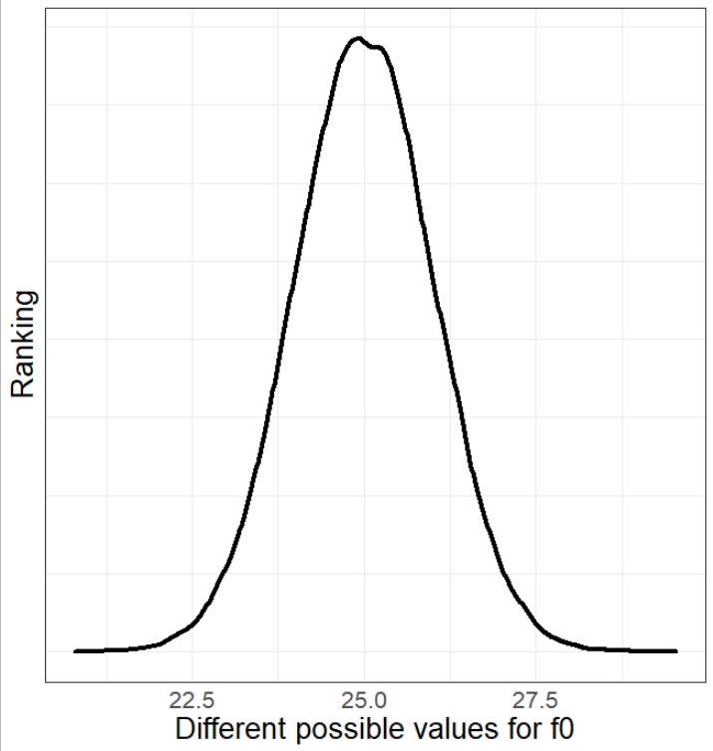
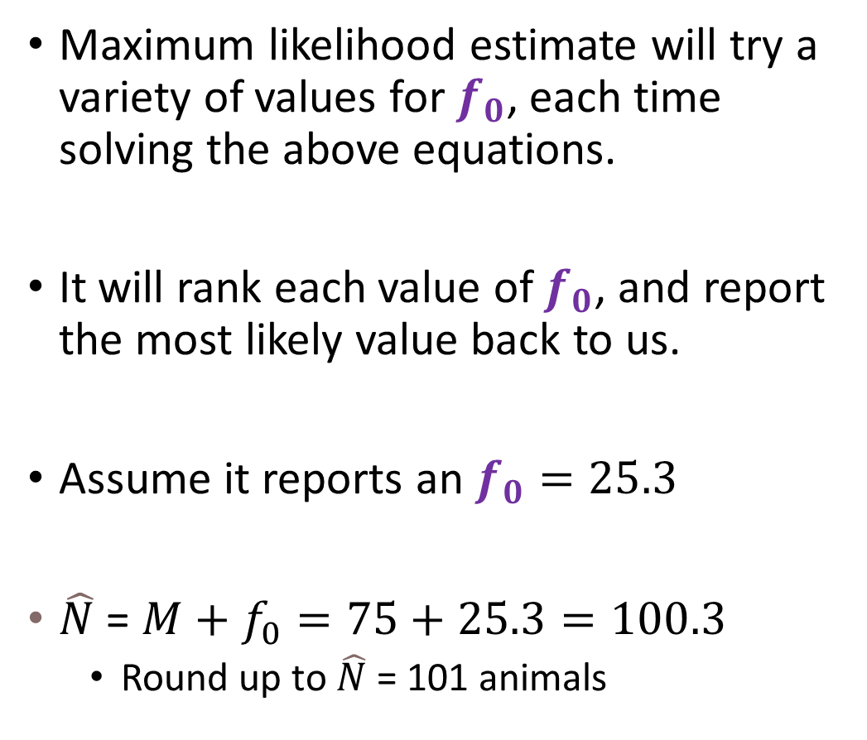
What does MLE suggest?
Maximum likelihood estimate will try a variety of values for $f_{0}$, each time solving the above equations.
It will rank each value of $f_{0}$, and report the most likely value back to us.
Assume it reports an $f_{0}=25.3$
$\hat{N}$ = $M+f_{0}=75+25.3=100.3$
Round up to $\hat{N}$ = 101 animals

Slide 22
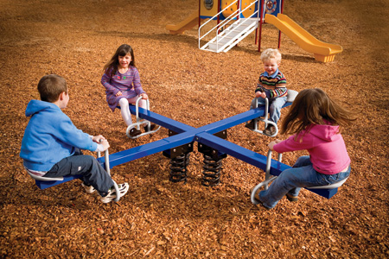
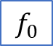
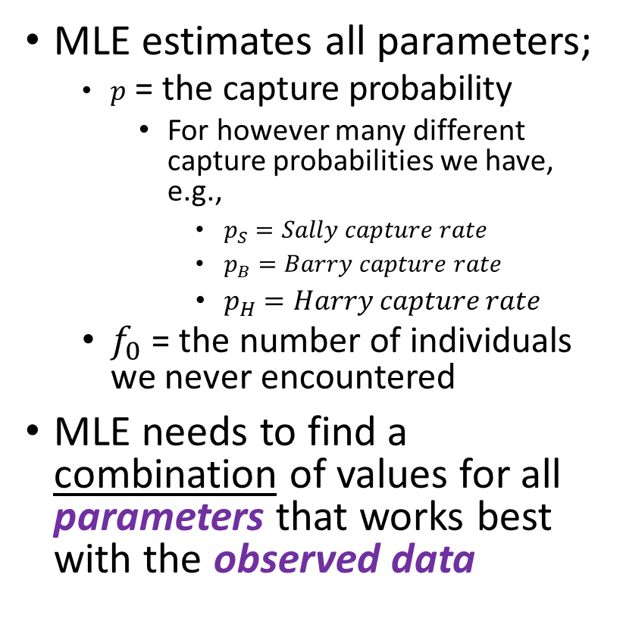



Using MLE to estimate parameters
MLE estimates all parameters;
$p$ = the capture probability
For however many different capture probabilities we have, e.g.,
$p_{S}=Sally capture rate$
$p_{B}=Barry capture rate$
$p_{H}=Harry capture rate$
$f_{0}$ = the number of individuals we never encountered
MLE needs to find a combination of values for all parameters that works best with the observed data
$$p_{S}$$
$$p_{H}$$
$$p_{B}$$
$$f_{0}$$

Slide 23

tl;dr
We extend from Lincoln-Petersen to more sophisticated K-samples models
Allows us to vary the probability of capture ($p$), so it does not need to be constant
Animals “flip biased coins to decide if they will be caught”
We use their capture histories to estimate what $p$ is
At the same time, we estimate how many animals we never caught
$f_{0}$ is the parameter for the number never caught
We use estimated $p$ values, as well as known number of individuals caught, to estimate $f_{0}$
Maximum Likelihood Estimation does the actual work, we just describe how we think we world might work

